Slide 1
Chapter 7. Pipelining
Dr. Ilavarasi A K, VIT Chennai

Slide 2
Overview
Pipelining is widely used in modern processors.
Pipelining improves system performance in terms of throughput.
Pipelined organization requires sophisticated compilation techniques.
Dr. Ilavarasi A K, VIT Chennai

Slide 3
Basic Concepts
Dr. Ilavarasi A K, VIT Chennai

Slide 4
Making the Execution of Programs Faster
Use faster circuit technology to build the processor and the main memory.
Arrange the hardware so that more than one operation can be performed at the same time.
In the latter way, the number of operations performed per second is increased even though the elapsed time needed to perform any one operation is not changed.
Dr. Ilavarasi A K, VIT Chennai

Slide 5
Traditional Pipeline Concept
Laundry Example
Ann, Brian, Cathy, Dave
each have one load of clothes
to wash, dry, and fold
Washer takes 30 minutes
Dryer takes 40 minutes
“Folder” takes 20 minutes
A
B
C
D
Dr. Ilavarasi A K, VIT Chennai

Slide 6
Traditional Pipeline Concept
6 PM
7
8
9
10
11
Midnight
Time
30
40
20
30
40
20
30
40
20
30
40
20
Sequential laundry takes 6 hours for 4 loads
If they learned pipelining, how long would laundry take?
A
B
C
D
Dr. Ilavarasi A K, VIT Chennai

Slide 7
Traditional Pipeline Concept
6 PM
7
8
9
10
11
Midnight
T
a
s
k
O
r
d
e
r
Time
30
40
40
40
40
20
A
Pipelined laundry takes 3.5 hours for 4 loads
B
C
D
Dr. Ilavarasi A K, VIT Chennai

Slide 8
Traditional Pipeline Concept
6 PM
7
8
9
Pipelining doesn’t help latency of single task, it helps throughput of entire workload
Pipeline rate limited by slowest pipeline stage
Multiple tasks operating simultaneously using different resources
Potential speedup = Number pipe stages
Unbalanced lengths of pipe stages reduces speedup
Time to “fill” pipeline and time to “drain” it reduces speedup
Stall for Dependences
Time
T
a
s
k
O
r
d
e
r
30
40
40
40
40
20
A
B
C
D
Dr. Ilavarasi A K, VIT Chennai

Slide 9
Use the Idea of Pipelining in a Computer
Fetch + Execution
T
ime
I
1
I
2
I
3
T
ime
Clock cycle
1
2
3
4
F
1
E
1
F
2
E
2
F
3
E
3
Instruction
(a) Sequential execution
I
1
F
1
E
1
I
2
F
2
E
2
Interstage buffer
B1
I
3
F
3
E
3
Instruction
Ex
ecution
fetch
unit
(c) Pipelined execution
unit
(b) Hardware organization
Figure 8.1. Basic idea of instruction pipelining.
Dr. Ilavarasi A K, VIT Chennai

Slide 10
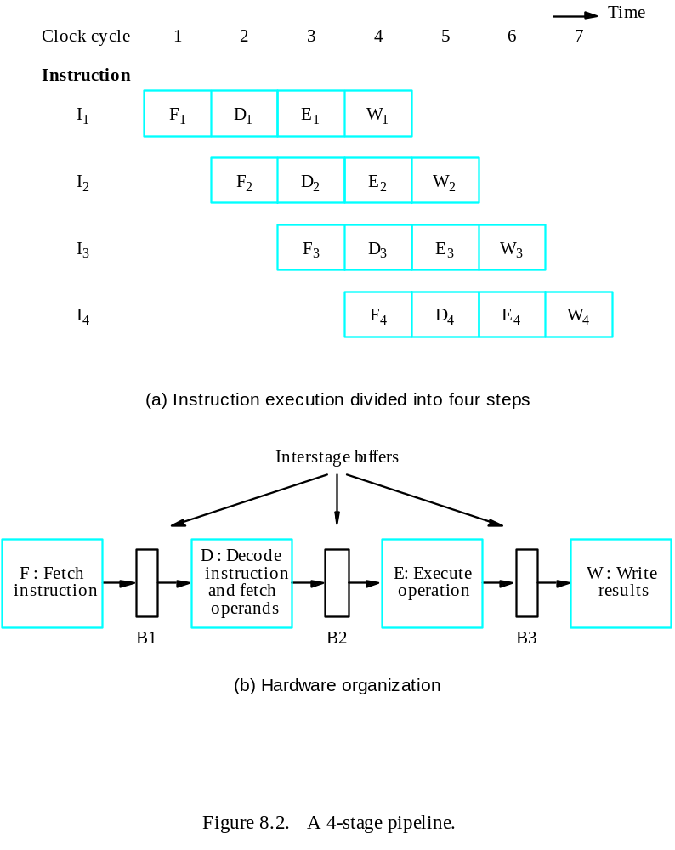
Use the Idea of Pipelining in a Computer
Fetch + Decode
+ Execution + Write
Dr. Ilavarasi A K, VIT Chennai

Slide 11
Role of Cache Memory
Each pipeline stage is expected to complete in one clock cycle.
The clock period should be long enough to let the slowest pipeline stage to complete- Risc Processors are easily pipelined
Faster stages can only wait for the slowest one to complete.
Since main memory is very slow compared to the execution, if each instruction needs to be fetched from main memory, pipeline is almost useless.
Fortunately, we have cache.
Dr. Ilavarasi A K, VIT Chennai

Slide 12
Pipeline Performance
The potential increase in performance resulting from pipelining is proportional to the number of pipeline stages.
However, this increase would be achieved only if all pipeline stages require the same time to complete, and there is no interruption throughout program execution.
Unfortunately, this is not true.
Dr. Ilavarasi A K, VIT Chennai

Slide 13
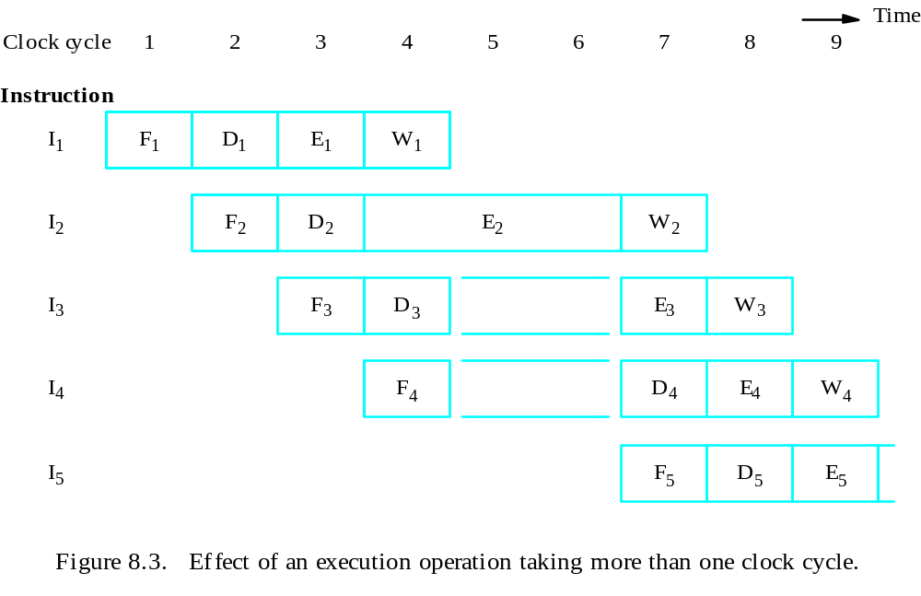
Pipeline Performance
Dr. Ilavarasi A K, VIT Chennai

Slide 14
Pipeline Performance
The previous pipeline is said to have been stalled for two clock cycles.
Any condition that causes a pipeline to stall is called a hazard.
Data hazard – any condition in which either the source or the destination operands of an instruction are not available at the time expected in the pipeline. So some operation has to be delayed, and the pipeline stalls.
Instruction (control) hazard – a delay in the availability of an instruction causes the pipeline to stall.
Structural hazard – the situation when two instructions require the use of a given hardware resource at the same time.
Dr. Ilavarasi A K, VIT Chennai

Slide 15
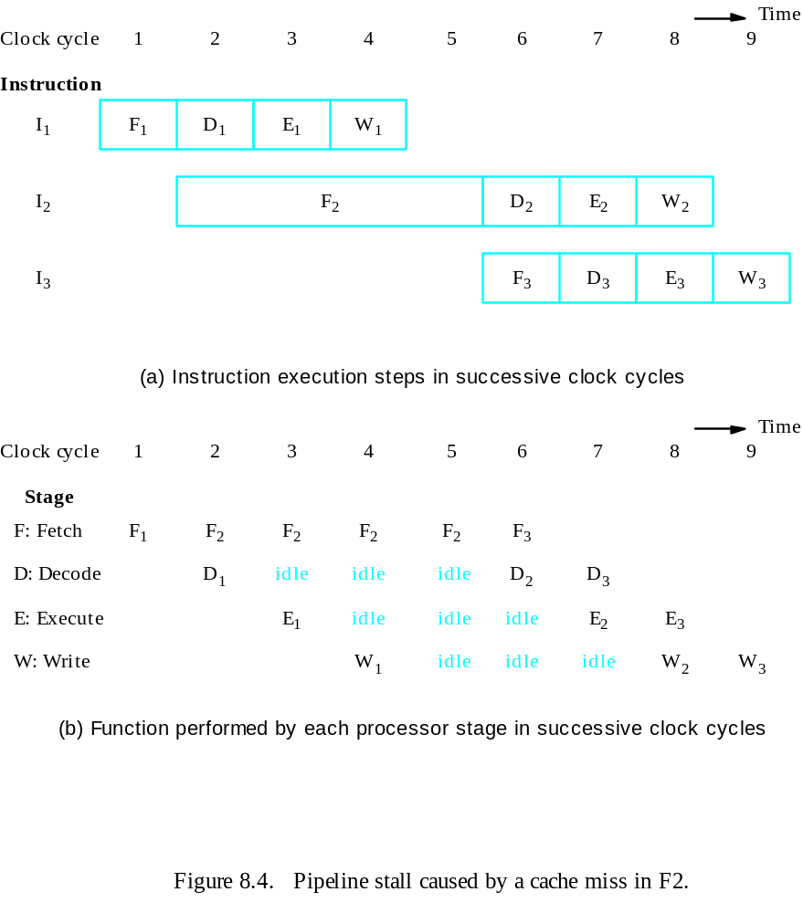
Pipeline Performance
Instruction hazard
Idle periods – stalls (bubbles)
Dr. Ilavarasi A K, VIT Chennai

Slide 16
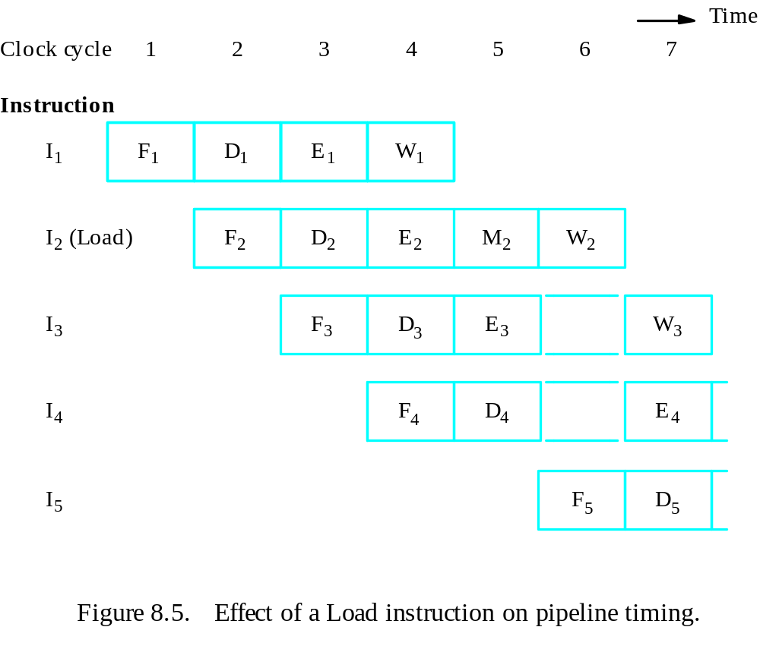
Pipeline Performance
Structural hazard
Load X(R1), R2
Dr. Ilavarasi A K, VIT Chennai

Slide 17
Pipeline Performance
Again, pipelining does not result in individual instructions being executed faster; rather, it is the throughput that increases.
Throughput is measured by the rate at which instruction execution is completed.
Pipeline stall causes degradation in pipeline performance.
We need to identify all hazards that may cause the pipeline to stall and to find ways to minimize their impact.
Dr. Ilavarasi A K, VIT Chennai

Slide 18
Quiz
Four instructions, the I2 takes two clock cycles for execution. draw the figure for 4-stage pipeline, and figure out the total cycles needed for the four instructions to complete.
10 instructions, the F And W takes 150ns for completion, other stages take 100 ns. A buffer of 2 ns is added to every stage. Draw the figure for 4-stage pipeline, and figure out the total time needed for the 10 instructions to complete
Dr. Ilavarasi A K, VIT Chennai

Slide 19
Data Hazards
Dr. Ilavarasi A K, VIT Chennai

Slide 20
Data Hazards
We must ensure that the results obtained when instructions are executed in a pipelined processor are identical to those obtained when the same instructions are executed sequentially.
Hazard occurs
A ← 3 + A
B ← 4 × A
No hazard
A ← 5 × C
B ← 20 + C
When two operations depend on each other, they must be executed sequentially in the correct order.
Another example:
Mul R2, R3, R4
Add R5, R4, R6
Dr. Ilavarasi A K, VIT Chennai

Slide 21
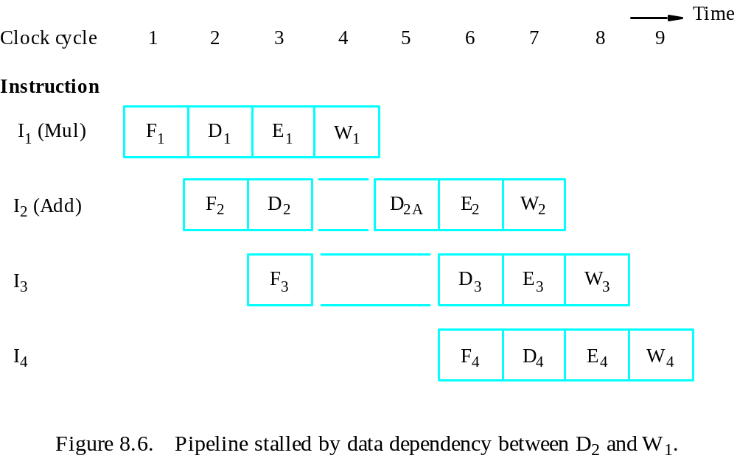
Data Hazards
Figure 8.6. Pipeline stalled by data dependency between D₂ and W₁.
Dr. Ilavarasi A K, VIT Chennai

Slide 22
Types of Data Hazards
Data Hazards Data hazards occur when instructions that exhibit data dependence, modify data in different stages of a pipeline. Hazard cause delays in the pipeline. There are mainly three types of data hazards:
1) RAW (Read after Write) [Flow/True data dependency]
2) WAR (Write after Read) [Anti-Data dependency]
3) WAW (Write after Write) [Output data dependency]
Let there be two instructions I and J, such that J follow I. Then,
RAW hazard occurs when instruction J tries to read data before instruction I writes it. Eg: I: R2 <- R1 + R3 J: R4 <- R2 + R3
WAR hazard occurs when instruction J tries to write data before instruction I reads it. Eg: I: R2 <- R1 + R3 J: R3 <- R4 + R5
WAW hazard occurs when instruction J tries to write output before instruction I writes it. Eg: I: R2 <- R1 + R3 J: R2 <- R4 + R5
Dr. Ilavarasi A K, VIT Chennai

Slide 23
Operand Forwarding
Instead of from the register file, the second instruction can get data directly from the output of ALU after the previous instruction is completed.
A special arrangement needs to be made to “forward” the output of ALU to the input of ALU.
Dr. Ilavarasi A K, VIT Chennai

Slide 24
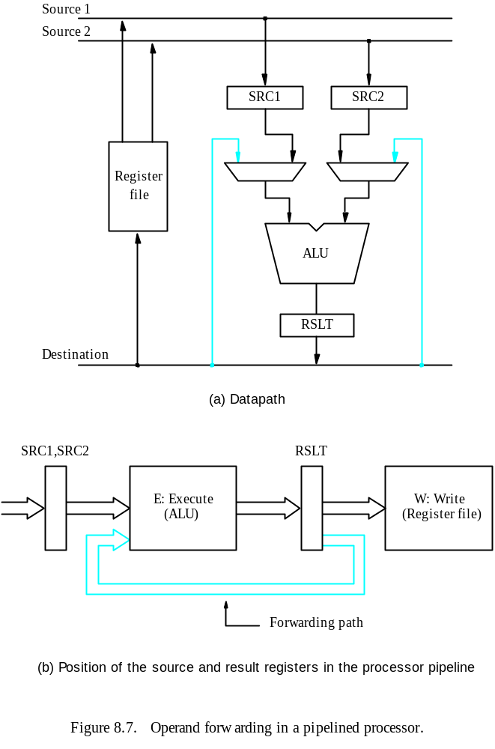
Dr. Ilavarasi A K, VIT Chennai

Slide 25
Handling Data Hazards in Software
Let the compiler detect and handle the hazard:
I1: Mul R2, R3, R4
NOP
NOP
I2: Add R5, R4, R6
The compiler can reorder the instructions to perform some useful work during the NOP slots.
Dr. Ilavarasi A K, VIT Chennai

Slide 26
Side Effects
The previous example is explicit and easily detected.
Sometimes an instruction changes the contents of a register other than the one named as the destination.
When a location other than one explicitly named in an instruction as a destination operand is affected, the instruction is said to have a side effect. (Example?)
Example: conditional code flags:
Add R1, R3
AddWithCarry R2, R4
Instructions designed for execution on pipelined hardware should have few side effects.
Dr. Ilavarasi A K, VIT Chennai

Slide 27
Instruction Hazards
Dr. Ilavarasi A K, VIT Chennai

Slide 28
Overview
Whenever the stream of instructions supplied by the instruction fetch unit is interrupted, the pipeline stalls.
Cache miss
Branch
Dr. Ilavarasi A K, VIT Chennai

Slide 29
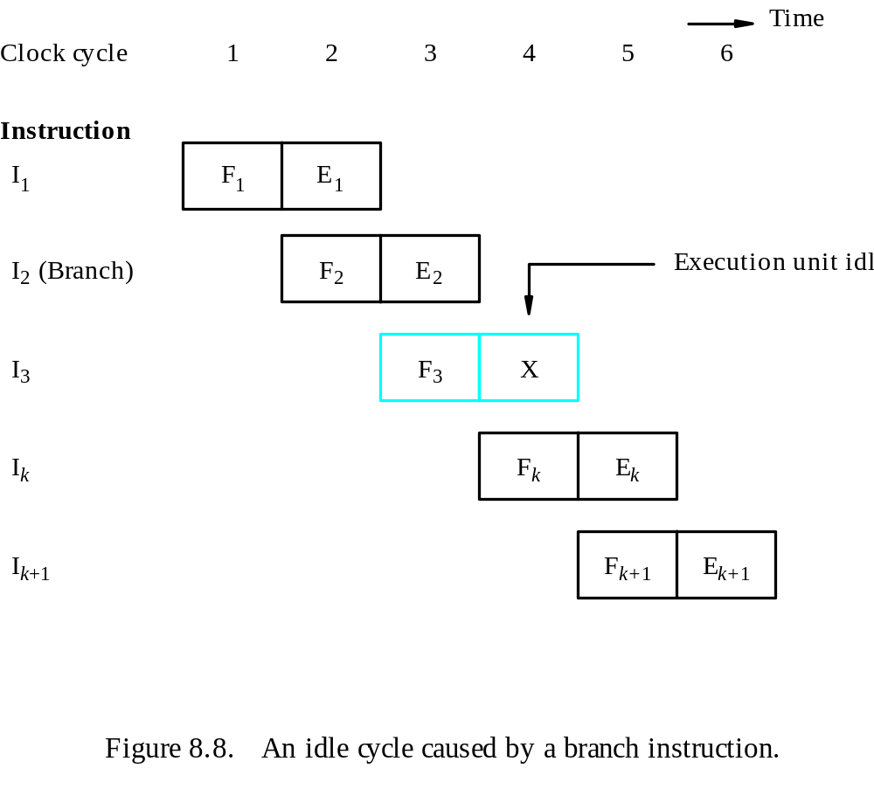
Unconditional Branches
Dr. Ilavarasi A K, VIT Chennai

Slide 30
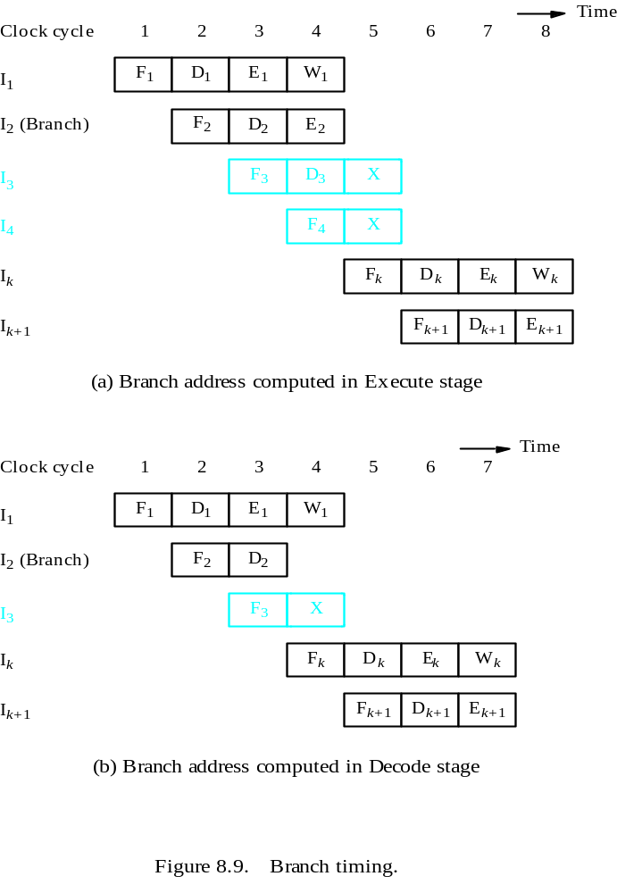
Branch Timing
- Branch penalty
- Reducing the penalty
Dr. Ilavarasi A K, VIT Chennai

Slide 31
Instruction Queue and Prefetching
Instruction fetch unit
Instruction queue
F : Fetch
instruction
D : Dispatch/
E : Ex
ecute
W : Write
Decode
instruction
results
unit
Figure 8.10. Use of an instruction queue in the hardware organization of Figure 8.2b.
Dr. Ilavarasi A K, VIT Chennai

Slide 32
Conditional Branches
A conditional branch instruction introduces the added hazard caused by the dependency of the branch condition on the result of a preceding instruction.
The decision to branch cannot be made until the execution of that instruction has been completed.
Branch instructions represent about 20% of the dynamic instruction count of most programs.
Dr. Ilavarasi A K, VIT Chennai

Slide 33
Delayed Branch
The instructions in the delay slots are always fetched. Therefore, we would like to arrange for them to be fully executed whether or not the branch is taken.
The objective is to place useful instructions in these slots.
The effectiveness of the delayed branch approach depends on how often it is possible to reorder instructions.
Dr. Ilavarasi A K, VIT Chennai

Slide 34
Delayed Branch
LOOP
Shift_left
R1
Decrement
R2
Branch=0
LOOP
NEXT
Add
R1,R3
(a) Original program loop
LOOP
Decrement
R2
Branch=0
LOOP
Shift_left
R1
NEXT
Add
R1,R3
(b) Reordered instructions
Dr. Ilavarasi A K, VIT Chennai
Figure 8.12. Reordering of instructions for a delayed branch.

Slide 35
Delayed Branch
T
ime
Clock c
ycle
1
2
3
4
5
6
7
8
Instruction
Decrement
F
E
Branch
F
E
Shift (delay slot)
F
E
Decrement (Branch tak
en)
F
E
Branch
F
E
Shift (delay slot)
F
E
Add (Branch not tak
en)
F
E
Dr. Ilavarasi A K, VIT Chennai
Figure 8.13. Execution timing showing the delay slot being filled
during the last two passes through the loop in Figure 8.12.

Slide 36
Branch Prediction
To predict whether or not a particular branch will be taken.
Simplest form: assume branch will not take place and continue to fetch instructions in sequential address order.
Until the branch is evaluated, instruction execution along the predicted path must be done on a speculative basis.
Speculative execution: instructions are executed before the processor is certain that they are in the correct execution sequence.
Need to be careful so that no processor registers or memory locations are updated until it is confirmed that these instructions should indeed be executed.
Dr. Ilavarasi A K, VIT Chennai

Slide 37
Incorrectly Predicted Branch
T
ime
Clock cycle
1
2
3
4
5
6
Instruction
I
1
(Compare)
F
1
D
1
E
1
W
1
I
2
(Branch>0)
F
2
D
2
/P
2
E
2
I
3
F
3
D
3
X
I
4
F
4
X
I
k
F
k
D
k
Figure 8.14. Timing when a branch decision has been incorrectly predicted
as not taken.
Dr. Ilavarasi A K, VIT Chennai

Slide 38
Branch Prediction
Better performance can be achieved if we arrange for some branch instructions to be predicted as taken and others as not taken.
Use hardware to observe whether the target address is lower or higher than that of the branch instruction.
Let compiler include a branch prediction bit.
So far the branch prediction decision is always the same every time a given instruction is executed – static branch prediction.
Dr. Ilavarasi A K, VIT Chennai

Slide 39
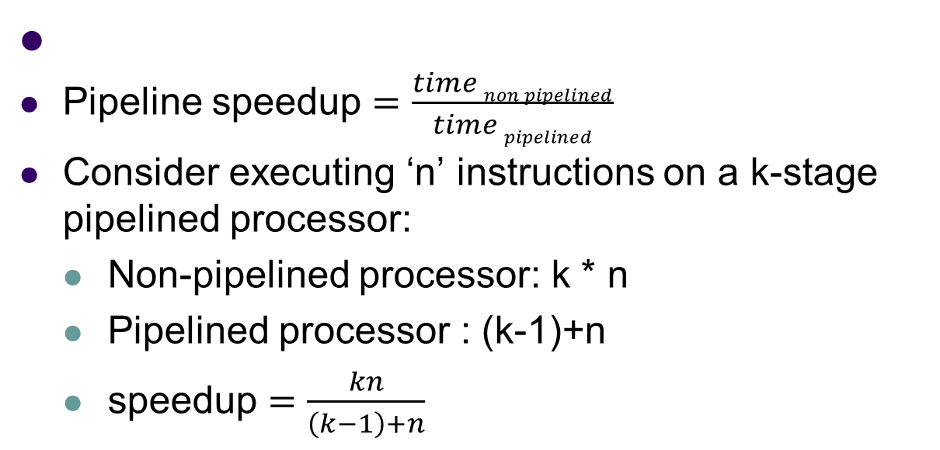
Pipeline speedup
Dr. Ilavarasi A K, VIT Chennai

Slide 40
problem
Consider a 11-stage instruction cycle. Find out the speedup achieved if a set of 50 instructions is run on a processor without pipelining and on the processor with pipelining.
Dr. Ilavarasi A K, VIT Chennai

Slide 41
Influence on Instruction Sets
Dr. Ilavarasi A K, VIT Chennai

Slide 42
Overview
Some instructions are much better suited to pipeline execution than others.
Addressing modes
Conditional code flags
Dr. Ilavarasi A K, VIT Chennai

Slide 43
Addressing Modes
Addressing modes include simple ones and complex ones.
In choosing the addressing modes to be implemented in a pipelined processor, we must consider the effect of each addressing mode on instruction flow in the pipeline:
Side effects
The extent to which complex addressing modes cause the pipeline to stall
Whether a given mode is likely to be used by compilers
Dr. Ilavarasi A K, VIT Chennai

Slide 44
Recall
Load X(R1), R2
Load (R1), R2
Dr. Ilavarasi A K, VIT Chennai

Slide 45
Complex Addressing Mode
Load (X(R1)), R2
T
ime
Clock c
ycle
1
2
3
4
5
6
7
Load
F
D
X
+
[R1]
[X
+
[R1]]
[[X
+
[R1]]]
W
F
orw
ard
Ne
xt instruction
F
D
E
W
(a) Complex addressing mode
Dr. Ilavarasi A K, VIT Chennai

Slide 46
Simple Addressing Mode
Add #X, R1, R2
Load (R2), R2
Load (R2), R2
Add
F
D
X
+
[R1]
W
Load
F
D
[X
+
[R1]]
W
Load
F
D
[[X
+
[R1]]]
W
Ne
xt instruction
F
D
E
W
Dr. Ilavarasi A K, VIT Chennai
(b) Simple addressing mode

Slide 47
Addressing Modes
In a pipelined processor, complex addressing modes do not necessarily lead to faster execution.
Advantage: reducing the number of instructions / program space
Disadvantage: cause pipeline to stall / more hardware to decode / not convenient for compiler to work with
Conclusion: complex addressing modes are not suitable for pipelined execution.
Dr. Ilavarasi A K, VIT Chennai

Slide 48
Addressing Modes
Good addressing modes should have:
Access to an operand does not require more than one access to the memory
Only load and store instruction access memory operands
The addressing modes used do not have side effects
Register, register indirect, index
Dr. Ilavarasi A K, VIT Chennai

Slide 49
Conditional Codes
If an optimizing compiler attempts to reorder instruction to avoid stalling the pipeline when branches or data dependencies between successive instructions occur, it must ensure that reordering does not cause a change in the outcome of a computation.
The dependency introduced by the condition-code flags reduces the flexibility available for the compiler to reorder instructions.
Dr. Ilavarasi A K, VIT Chennai

Slide 50
Conditional Codes
Add
R1,R2
Compare
R3,R4
Branch=0
. . .
(a) A program fragment
Compare
R3,R4
Add
R1,R2
Branch=0
. . .
(b) Instructions reordered
Dr. Ilavarasi A K, VIT Chennai
Figure 8.17. Instruction reordering.

Slide 51
Conditional Codes
conclusion:
To provide flexibility in reordering instructions, the condition-code flags should be affected by as few instruction as possible.
The compiler should be able to specify in which instructions of a program the condition codes are affected and in which they are not.
Dr. Ilavarasi A K, VIT Chennai

Slide 52
Datapath and Control Considerations
Dr. Ilavarasi A K, VIT Chennai

Slide 53
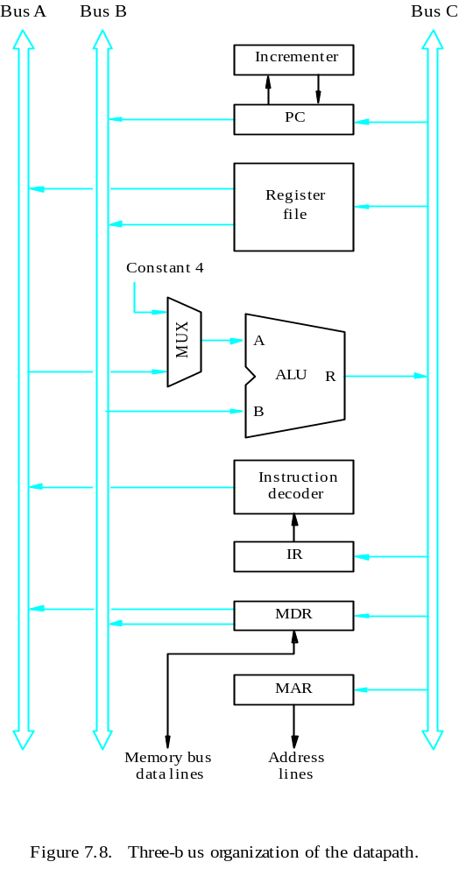
Original Design
Dr. Ilavarasi A K, VIT Chennai

Slide 54
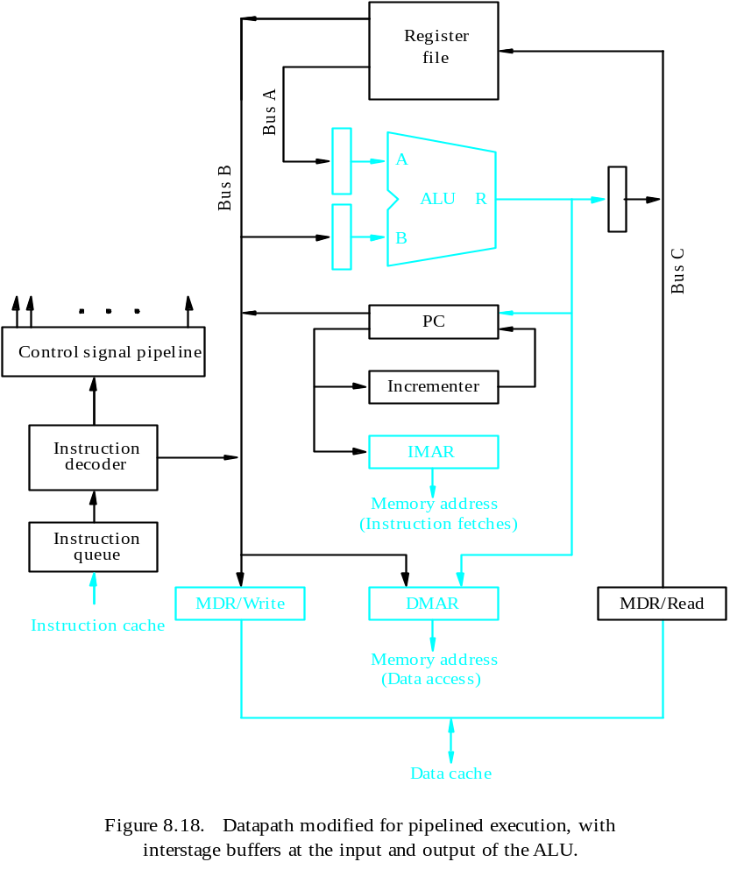
Pipelined Design
- Separate instruction and data caches
- PC is connected to IMAR
- DMAR
- Separate MDR
- Buffers for ALU
- Instruction queue
- Instruction decoder output
- Reading an instruction from the instruction cache
- Incrementing the PC
- Decoding an instruction
- Reading from or writing into the data cache
- Reading the contents of up to two regs
- Writing into one register in the reg file
- Performing an ALU operation
Dr. Ilavarasi A K, VIT Chennai

Slide 55
Superscalar Operation
Dr. Ilavarasi A K, VIT Chennai

Slide 56
Overview
The maximum throughput of a pipelined processor is one instruction per clock cycle.
If we equip the processor with multiple processing units to handle several instructions in parallel in each processing stage, several instructions start execution in the same clock cycle – multiple-issue.
Processors are capable of achieving an instruction execution throughput of more than one instruction per cycle – superscalar processors.
Multiple-issue requires a wider path to the cache and multiple execution units.
Dr. Ilavarasi A K, VIT Chennai

Slide 57
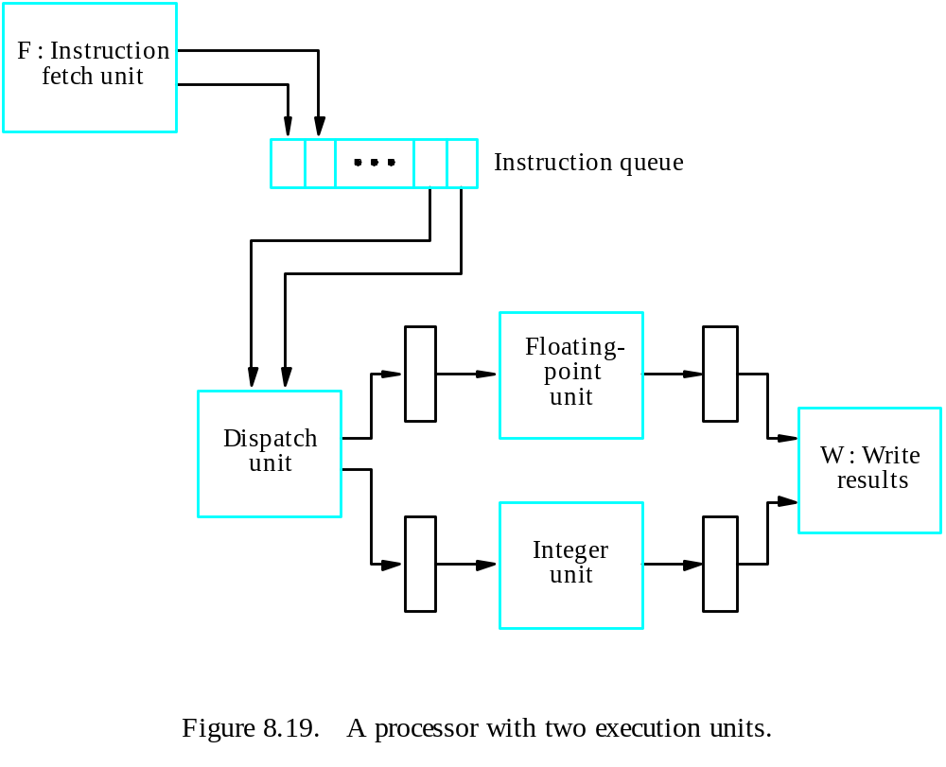
Superscalar
Dr. Ilavarasi A K, VIT Chennai

Slide 58
Timing
T
ime
Clock c
ycle
1
2
3
4
5
6
7
I
1
(F
add)
F
D
E
E
E
W
1
1
1A
1B
1C
1
I
2
(Add)
F
D
E
W
2
2
2
2
I
3
(Fsub)
F
D
E
E
E
W
3
3
3
3
3
3
I
4
(Sub)
F
D
E
W
4
4
4
4
Figure 8.20. An example of instruction execution flow in the processor of Figure 8.19,
assuming no hazards are encountered.
Dr. Ilavarasi A K, VIT Chennai

